Slide 1
Stock Price prediction using Big Data Visualization Technique
Priyanka Vyas, Nibedita Roy,
pvyas2@kent.edu , nroy2@kent.edu
Department of Computer Science
Kent State University
Notes:
Goodmorning everyone!
My team-mate Nibedita and I are today presenting the weekly progress on the capstone project i.e. Stock Price prediction using Big Data Visualization technique and before we start I will take some time to quickly brief on the what we presented so far.

Slide 2
Problem Statement:
-Prediction of future movement of stock prices
Proposed Solution:
- Neural networks model
- Monitor the price movement
- Visualization method to present and analysis the result

Slide 3
Prediction Model Approach
Tableau (Problem statement visualization
Milestone 2
Sequential Learning
Attribute: Close Price
No. of layers: 4
Window size nstep: 100
Loss Function:MSE
Optimizer: Adam
Epochs: 20
Batch size:64
Parameters: 50851
LSTM
Training Set
Historical Data (10)yr
Price Prediction based on ‘Close’ Stock price data
Visualization using Matplotlib and Altair
Test Set
Milestone 1
Milestone 4
Model Evaluation (Performance test)
using Mean Square Error ( MSE)
Matplotlib (Performance Visualization)
Milestone 3
Notes:
The Prediction model approach for our project is elaborated as shown in slide in Milestones respectively:
Milestone 1
Milestone 2
Milestone 3
Milestone 4

Slide 4
Explored the dataset
Visualized the components in dataset
Selected the parameter for data preprocessing
Milestone 1 : Data Collection
Notes:
Explored the dataset
Code for downloading the dataset from the source
Finalize which part of the dataset you will work on and what feature you will implement
Study relevant frameworks (tensorflow, pytoroch, or any other framework)

Slide 5
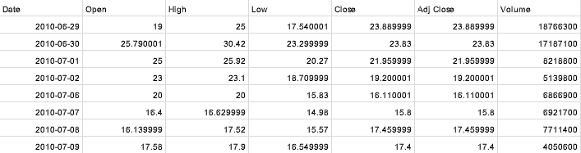
Features of Dataset
Properties:
•Total sample size: 2517
•Training set size: Model 1, training size 65% and Model 2, training size 80%
•Test set size: Balance %
• Dataset parameters/ Categories:Date,Open,High,Low, Close, Adj Close and Volume
Notes:
Financial data can be bought, manually scraped from the web, or obtained from public APIs. Generally, financial data comes in one of 2 primary types:Structured Data: Closing prices, financials, market performance, etc.Unstructured Data: News articles, Social Media, Sentiment Analysis, etc. Additionally, financial data can be further categorized as either Historical or Real-Time. In most cases, Real-Time data isn’t available from public APIs and must be purchased. We’ll be using mostly structured historical data for our examples here. These financial data are generally provided in a format that includes the following information:
Date
Open Price
High Price
Low Price
Closing Price
Volume
Adj close price

Slide 6
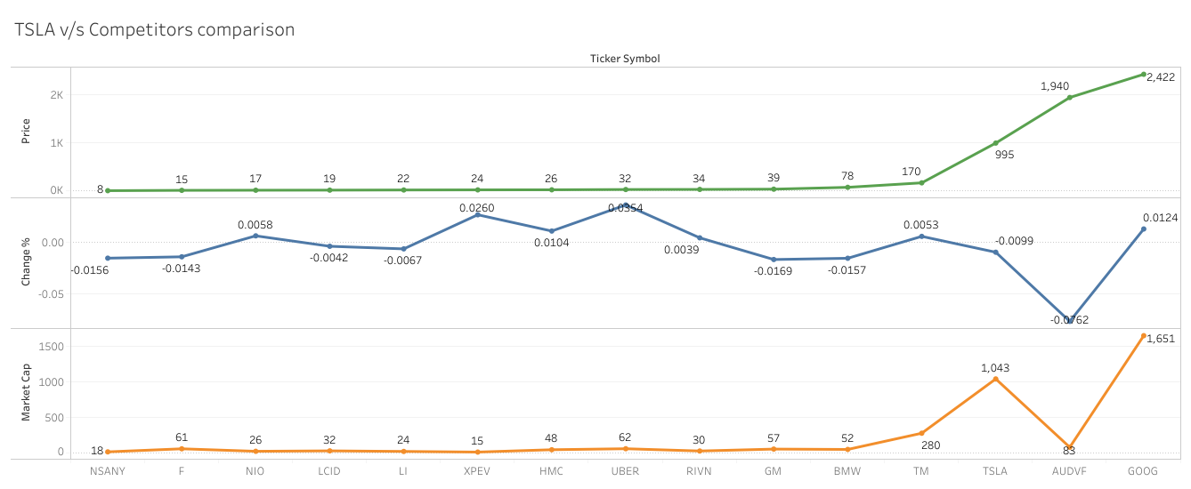
Notes:
Tesla Competitors Comparative study of Stock price movement
-Direct Competitors, -Indirect Competitors:
The graph shows a plot with stock data dated 04/24/2022 and here we have compared the parameters using Tableau to study the stock price movement in line with companies Market Cap, %change in stock price and closing stock price (i.e. Avg close).
While devising this comparison since our focus was mainly on Tesla, we prepared a comparative between direct competitors of Tesla i.e. from the automobile industry and Indirect competitors from Software and IT services and as we can see from the plot that stock price of Tesla, Audi and Google are rising and compared to the market capital of Tesla and Audi, Tesla has more capital infusion compared to peers as Tesla works on the ability to generate recurring sales and potential to add to profits.
Tesla is also an indirect competitor of Uber and Google. This is because Tesla, Uber and Google are working on self-driving car projects which means that Uber and Google are indirect competitors of Tesla.

Slide 7
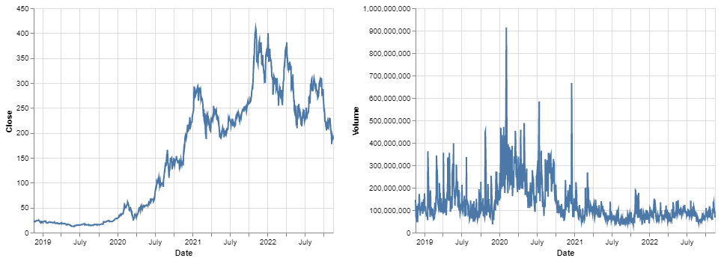
Visualization Close price and Vol
Notes:
Stock price analysis is an example of time series analysis and is one of the primary area in predictive analytics. The time series data contains measurements or observations attached to sequential time steps. In case of stock prices, the time stamps can seconds, minutes or days.
In this project we have used pandas for data manipulation and altair, matplotlib for data visualization. For visualization through altair we have used the data reader API of Pandas. We first import the dependencies necessary for the project and then used data reader to create Pandas dataframe that contain stock price data.
Altair makes it simple to have multiple plots in one visualization. As we can see in the slide we can plot closing price movement and volume for TSLA stocks using a logical operator.The data is for time period 2018-2022 as Altair has a limitation to visualize upto 5000 records.

Slide 8
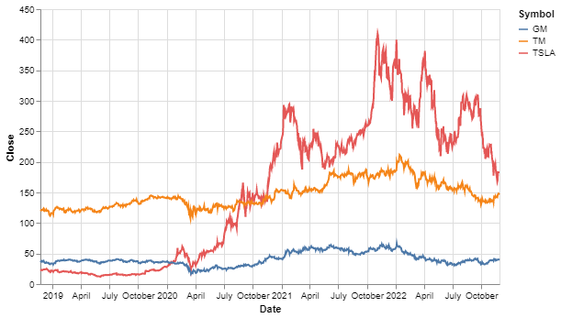
Visualization: Close price_date
Notes:
We can also show a comparative chart in one visualization using altair The stocks of both stocks seems to continuously increasing with few occasional drop, one in April 2020 and other since october 2022 mainly related to global pandemic and anticipated recession.
Resampling means representing data with different frequency.

Slide 9
Milestone 2 :Data Preprocessing
Download the stock price dataset: yfinance
Load .csv file as dataframe using Pandas
Plot Close values using .pyplot
Import the libraries
Build model using Tensorflow keras and preprocessed data using scikit-learn
Normalize or rescale data using Minmax scaler and reshape it
Rescale values between -1 and 1
For total Sample size
Split the dataset into Training and Test set size
Define window size ‘n_step’ of data in each training step
X is n_step less than original dataset
Notes:
The objective of the proposed work is to study and improve the supervised learning algorithms to predict the stock price.

Slide 10
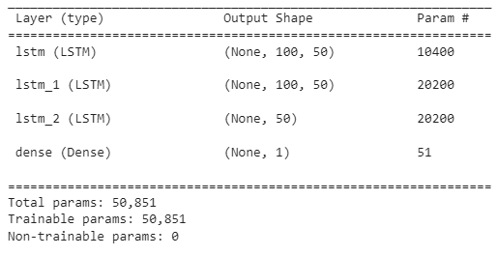
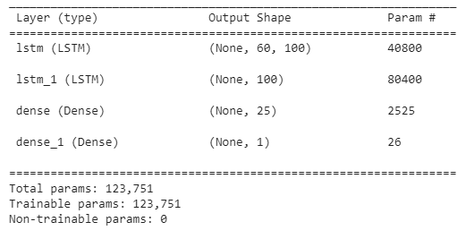
Milestone 3: Result Analyze: Layers & Parameter
Model 1
Model II
Notes:
Model 1: nstep 100, training size 65% remaining test size data, nstep means 100 days timestep
Model 2: nstep 60, training size 80% remaining test size data, nstep means 60 days timestep
when we are decreasing the time steps and increasing the training size the total parameter is increasing a lot.
We have build the model using LSTM and added layers as shown in the slide.
Model 1 has 3 LSTM layers with 100,100 and 50 neurons resp and 1 Dense layer with output dimension 1.
Model 2 has 2 LSTM layers with 60 and 50 neurons resp and 2 Dense layer with output dimension 25 and 1 respectively.

Slide 11
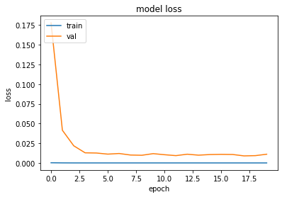
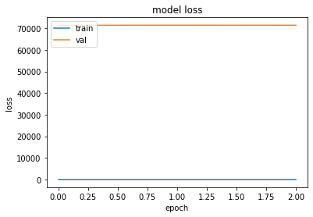
Result Analyze: Epochs & Batchsize
Model 1: Epoch=20, Batchsize=64
Model II: Epoch=3, Batchsize=20
Notes:
Underfitting vs overfitting
model 1: the performance of the model is good on both the train and validation set.
model2: the plot of train and validation loss showing the characteristics of underfit model.
Model 1 is updated with with a batch size of 64 and epochs 20, the plots shows that after a certain epochs the model manages to follow the trend.
Model 2 is updated with with a batch size of 20 and epochs 3, the plots shows that the model manages to follow the trend from the first epoch run.
The plots in the slide are the diagnostic plot that shows the model behaviour. All result and analysis plots has been made using Matplotlib library. The training loss v/s val loss(test loss)
model 1: the performance of the model is good on both the train and validation set.The plot shows the train and val loss decrease and stabilise around the same point.
model2: the plot of train and validation loss showing the characteristics of underfit model. The performance of the model may be improved by increasing the capacity of the model, such as number of neurons in the layers or number of hidden layer(LSTM layer).

Slide 12
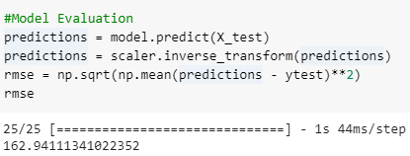
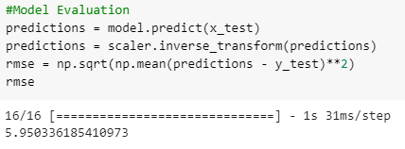
Result Analyze:Loss function:RMSE
Model 1: RMSE=162
Model II: RMSE=5.9
Notes:
Model Evaluation using MSE
model 1: our data is badly overfit
model2:model is better fitted.
We evaluated the model for predictions using the loss function root mean square error and it is observed that
for Model 1 = RMSE is 162 which means the model badly overfits the data but it tests well in the sample and has little predictive value when tested out of the sample size and Model 2= RMSE is 5.95 that shows model is able to fit the dataset and is giving better predictions.
RMSE score shows how far prediction falls from the measured true values using Euclidean Distance. The RMSE statistic provides information about the short-term performance of a model by allowing a term-by-term comparison of the actual difference between the estimated and the measured value [140]. The smaller the value, the better the model's performance.

Slide 13
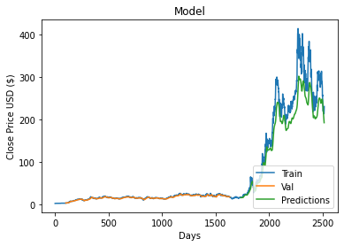
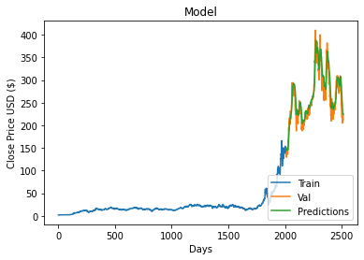
Result Analyze
Model 1
Model II
Notes:
Both the models performed fairly good. We can fairly follow the unexpected jumps and drops however, for the most recent date stamps, we can see that the model expected (predicted) lower values compared to real values of the stock price.

Slide 14
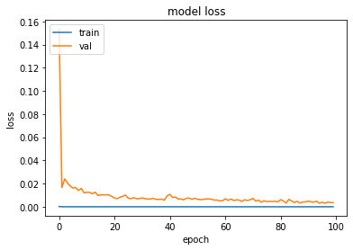
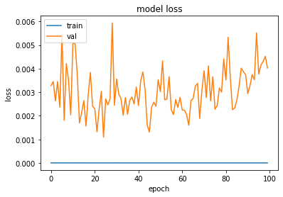
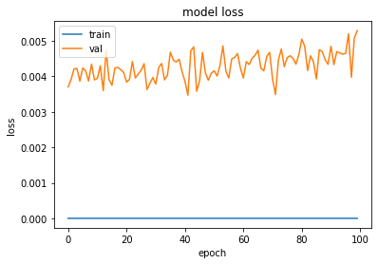
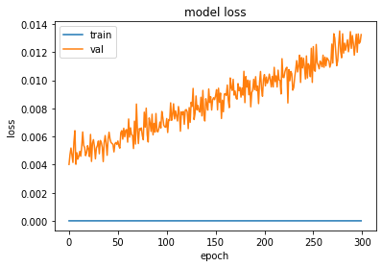
Plot:Epoch v/s Loss for Model I
epochs=100,batch_size=64
epochs=100,batch_size=30
epochs=100,batch_size=125
epochs=300,batch_size=64

Slide 15
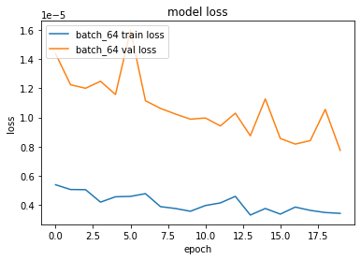
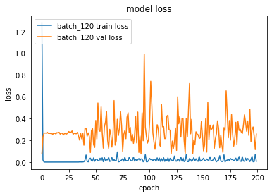
Plot: Batch v/s Loss for Model I

Slide 16
Thank You

